Slide 1
Guided Capstone
Rehan Khan
Springboard Data Science

Slide 2
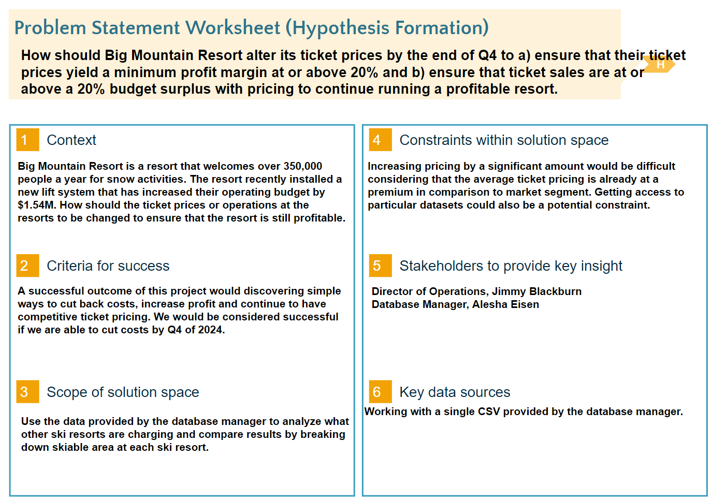
Problem Identification

Slide 3
Recommendations
Increase the suggested ticket price to $91.36
The model suggest closing 5 of the least used runs which is the most runs you can close without further loss to ticket price.

Slide 4
Modeling Results
We used the following models to get our result:
Linear Regression Model
A linear approach for modelling the relationship between dependent variable and response of one or multiple independent variable
Random Forest Regression Model
Supervised learning algorithm that helps create a structure a multitude of decision trees.

Slide 5
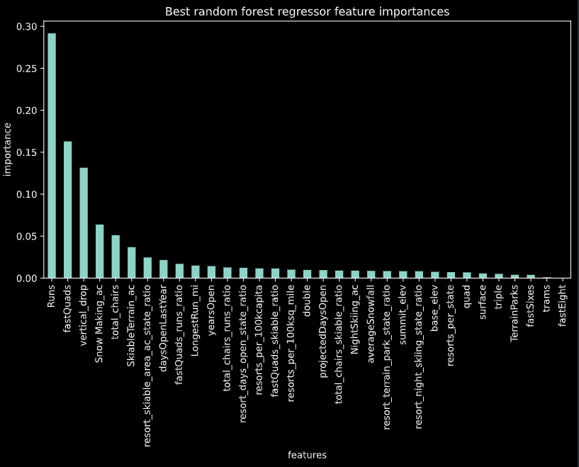
Random Forest Results
Reveals that most important features in pricing include:
Runs
Fast Quads
Vertical Drop
Snow Making
Total Chairs
Skiable Terrain

Slide 6
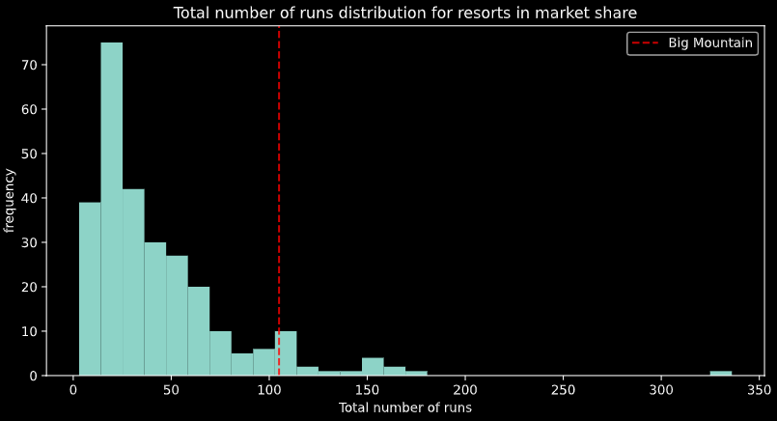
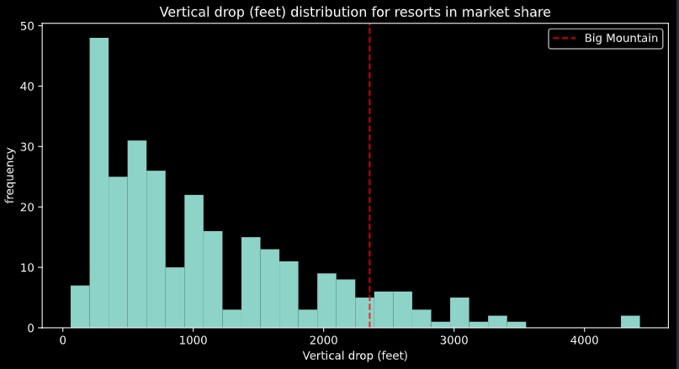
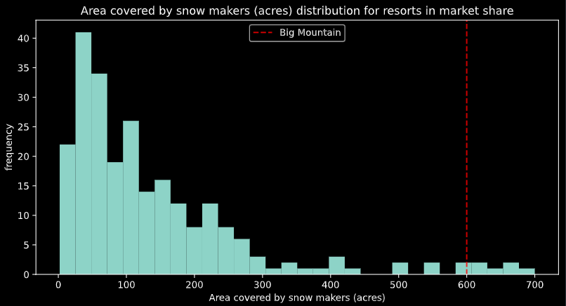
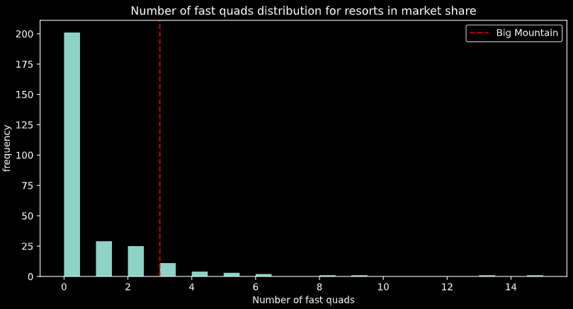
Big Mountain Market Comparison
- Red dashed line shows Big Mountain versus other resorts.

Slide 7
Conclusion
We suggest Big Mountain close the least used runs while increasing their ticket price based on the model’s prediction.
The final suggested ticket price is $91.36. This is on the high end for ski resorts in Montana but is justified based on factors such as Vertical Drop, Number of Runs and Number of FastQuads which are all large determinants of ticket prices where Big Mountain outperforms the other resorts in the same market.

Slide 8




Thank you

